Slide 1
Population Demographics and Management of White Sturgeon in the Sacramento-San Joaquin River System, California
Shannon E. Blackburn
Idaho Cooperative Fish and Wildlife Research Unit
Department of Fish and Wildlife Sciences, University of Idaho
Marty L. Gingras and Jason DuBois
California Department of Fish and Wildlife
Zachary J. Jackson
U.S. Fish and Wildlife Service
Michael C. Quist
U.S. Geological Survey, Idaho Cooperative Fish and Wildlife Research Unit, Department of Fish and Wildlife Sciences, University of Idaho

Slide 2
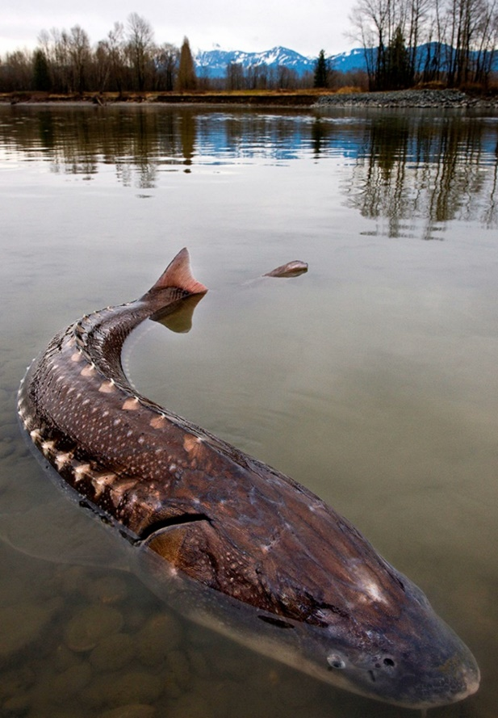
White Sturgeon
Ecology
Large
Long lived
Late maturing
Periodic spawning
Distribution
Status
Declining
Andrew S. Wright

Slide 3
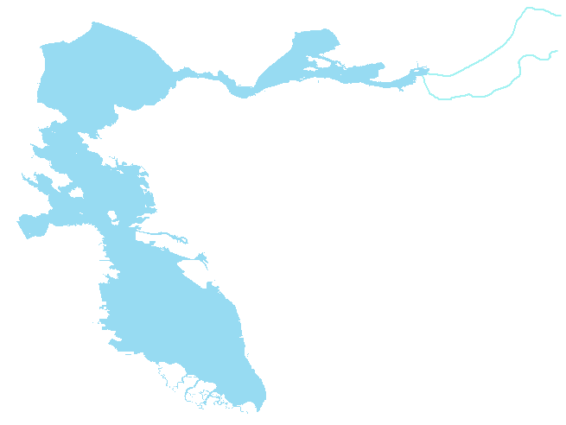
San Pablo Bay
Sacramento River
San Joaquin River
Suisun Bay
San Francisco Bay

Slide 4

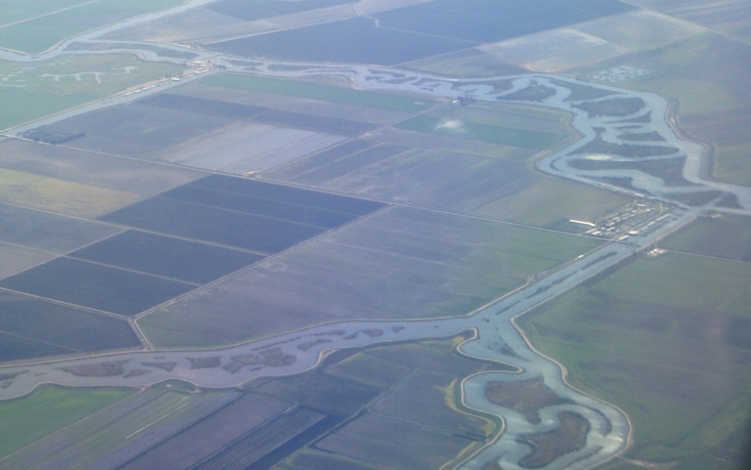
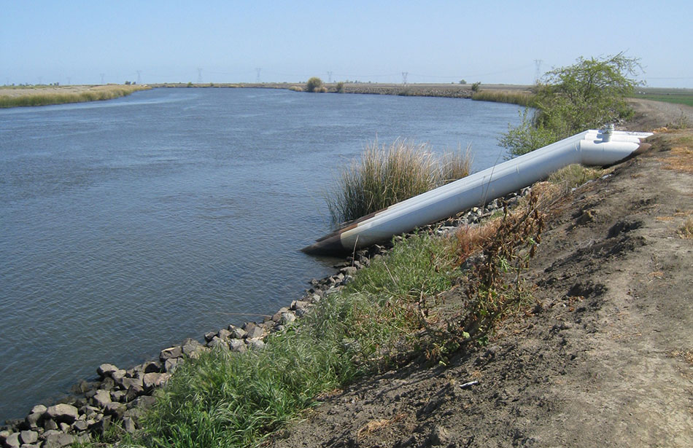
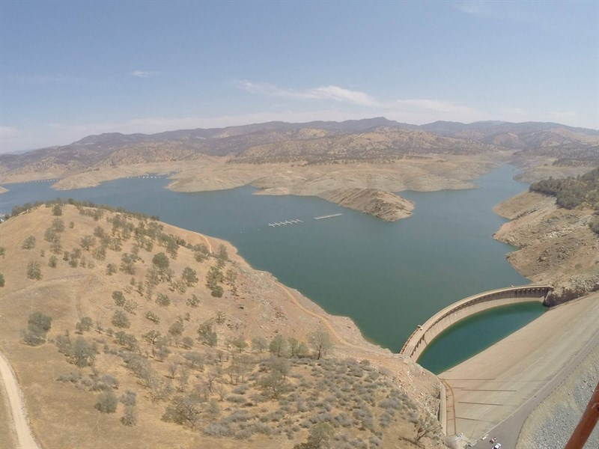

Slide 5
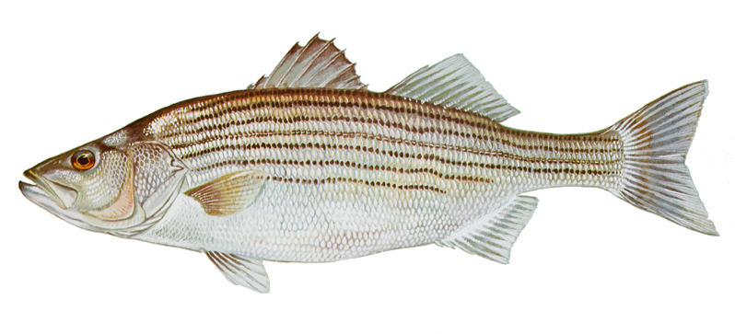
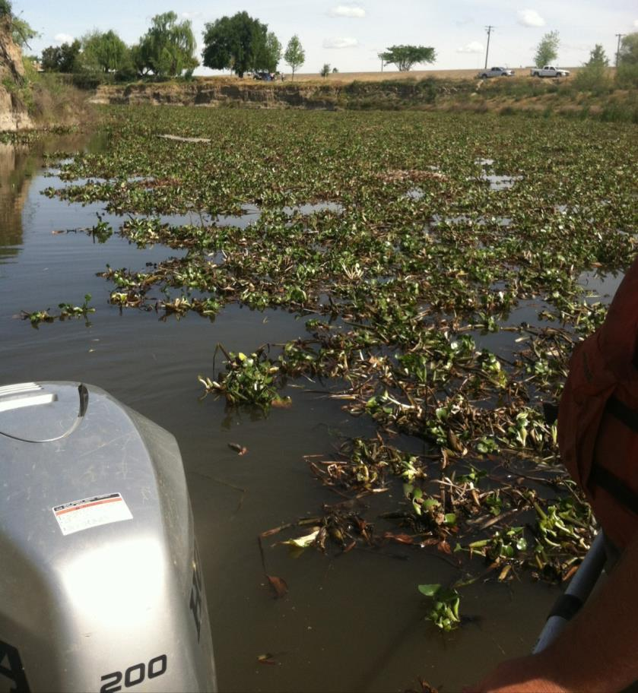
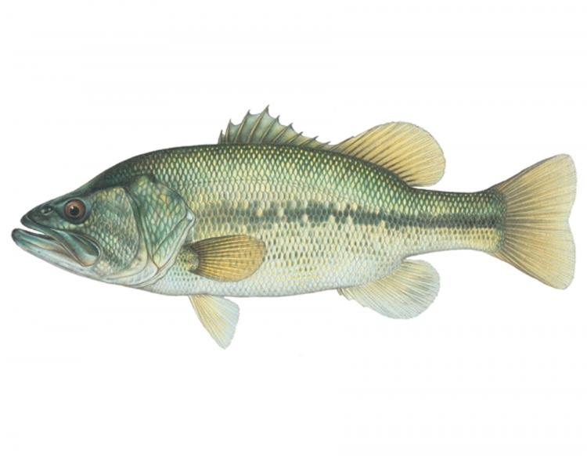
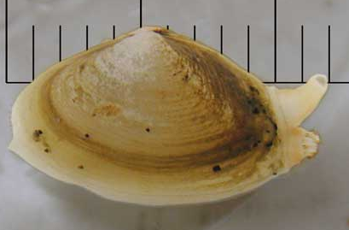
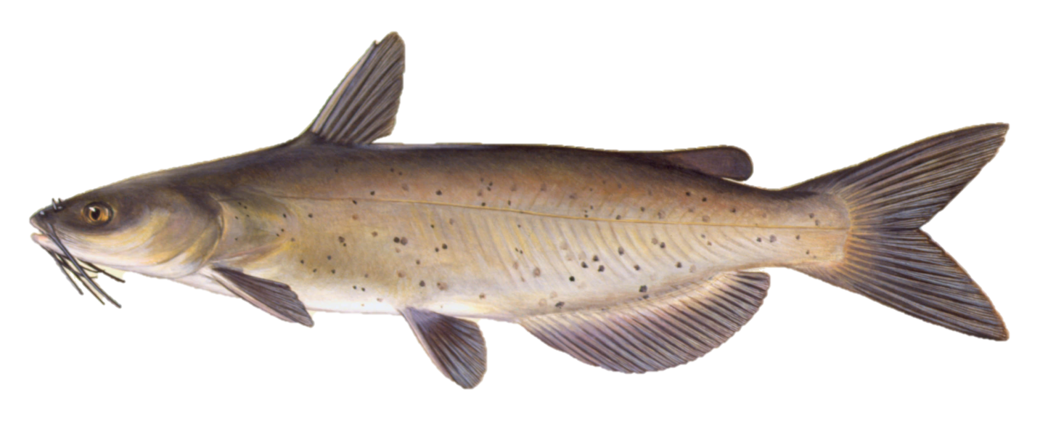

Slide 6
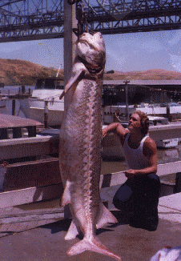
Exploitation
Historic commercial harvest
Recreational angling
Re-opened in 1954
Exploitation (μ): 2 – 11%
Incomplete information
Angler non-compliance
Illegal harvest

Slide 7
Age-0 White Sturgeon

Slide 8
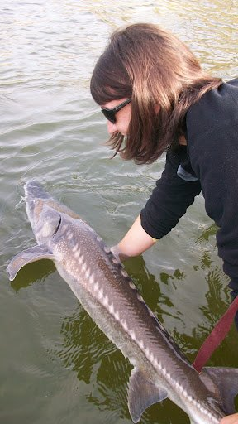
Management Concerns
Harvest slot
102 – 152 cm fork length
Harvest allocation
Bag limit: 3 fish per year
Approximately:
~ 50,000 anglers
~ 48,000 White Sturgeon
DuBois and Gingras (2011)
2006 and 2011 cohorts

Slide 9
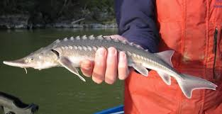
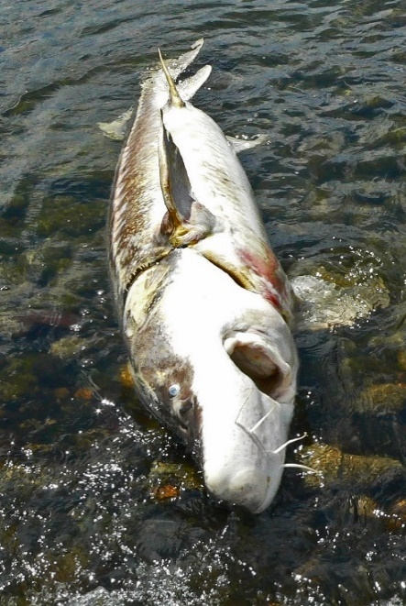
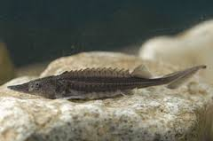
Objectives
Describe population demographics and dynamics
Model population growth of White Sturgeon under different management scenarios
Growth
Natural mortality
Recruitment
Fishing mortality

Slide 10
Methods
CDFW Sturgeon Study
Suisun Bay
Summer and fall
2014 – 2016
Sacramento River
San Joaquin River

Slide 11
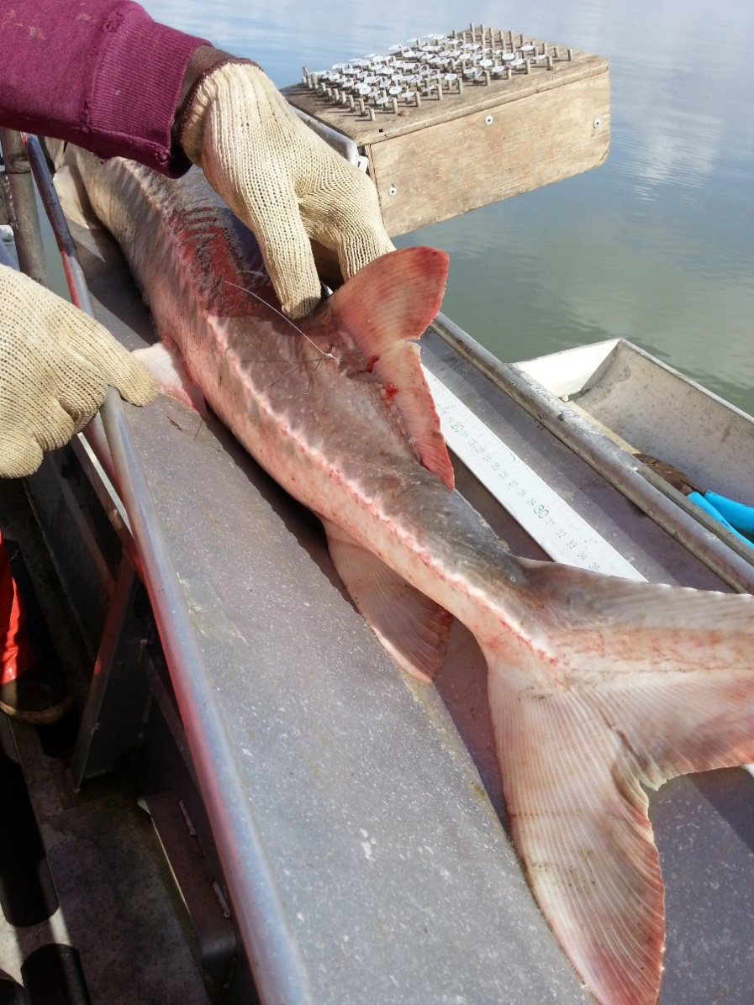
Methods
Sampling methods
Trammel netting
Processing
Length
Tagging
Disc-dangler reward tag
Pectoral fin ray removal

Slide 12
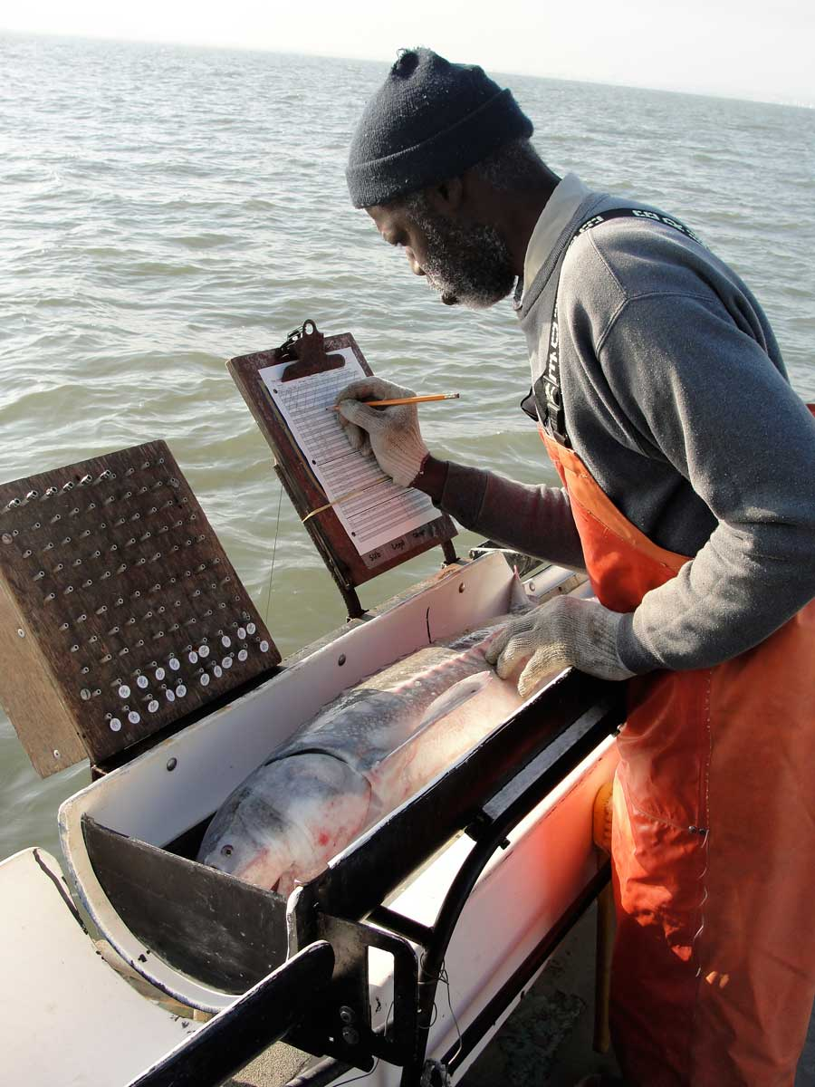
Methods
Age
Growth
von Bertalanffy
Mortality
Total annual mortality
Exploitation
Maturity
Probability of maturity
Chapman (1989)
Chapman et al. (1996)
Fecundity
DeVore et al. (1995)

Slide 13
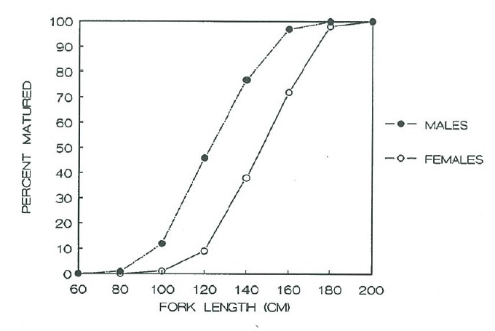
Maturity
Chapman (1989)

Slide 14
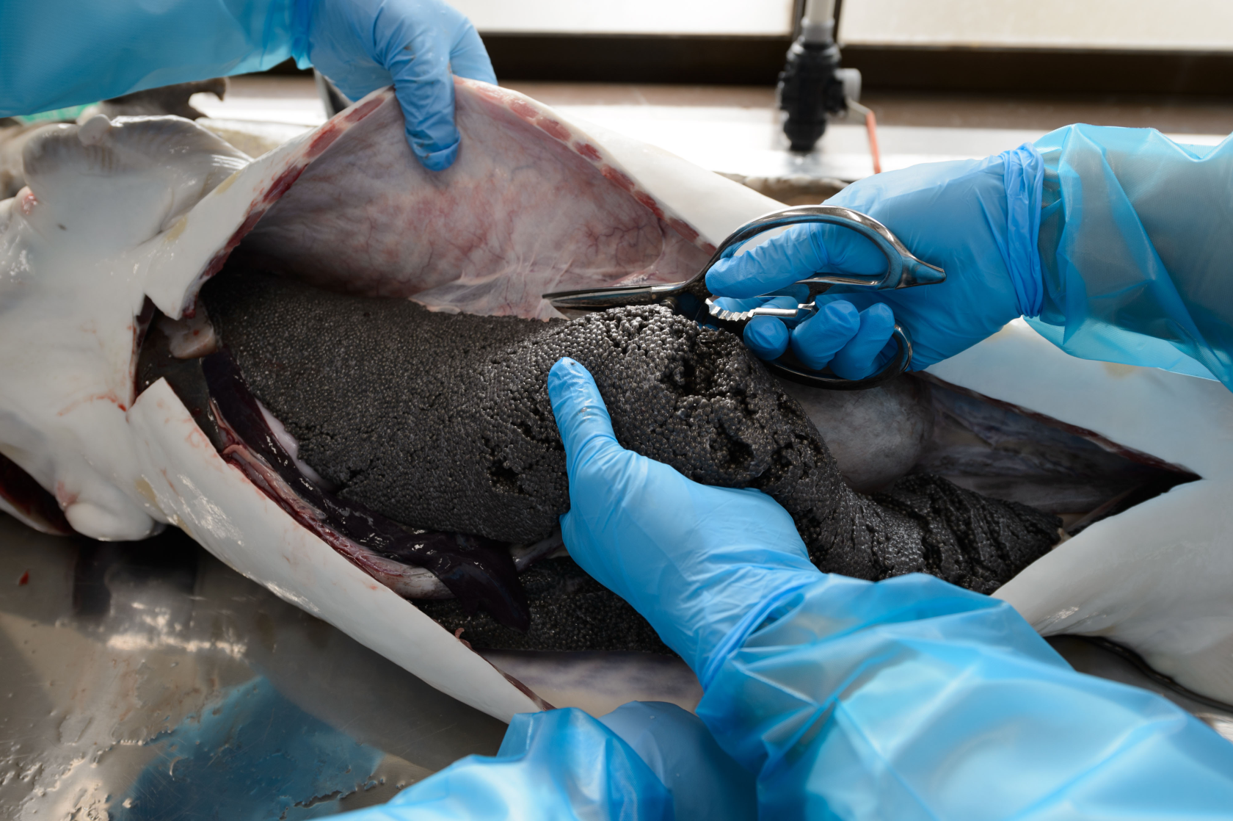
Fecundity

Slide 15
Fecundity
Fork length (cm) | DeVore et al. (1995) | Chapman et al. (1996)
125 | 105,256 | 92,484
145 | 162,837 | 149,415
165 | 238,087 | 226,861
185 | 333,286 | 328,361
195 | 389,076 | 389,267

Slide 16
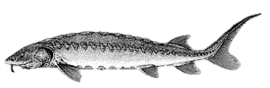
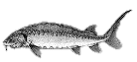
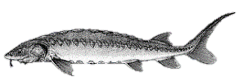
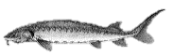
Population Modeling
R_{i} = P_{i} × f_{i} × a × s_{i}
s₀
s₁
…
s₉
s₁₀
…
s₁₉
age 0
age 1
age 10
age 19+

Slide 17
Population Modeling
Spawning periodicity
10%
15%
25%
Slot length limit
Current (102 – 152 cm)
Smaller (76 – 112 cm)
Larger (127 – 179 cm)
Exploitation
μ : 0.00 – 0.30

Slide 18
Population Modeling
Population modeling
Population growth rate (λ)
Each scenario combination:
1,000 times
10, 20, and 50 years
Successful recruitment every 7 years

Slide 19
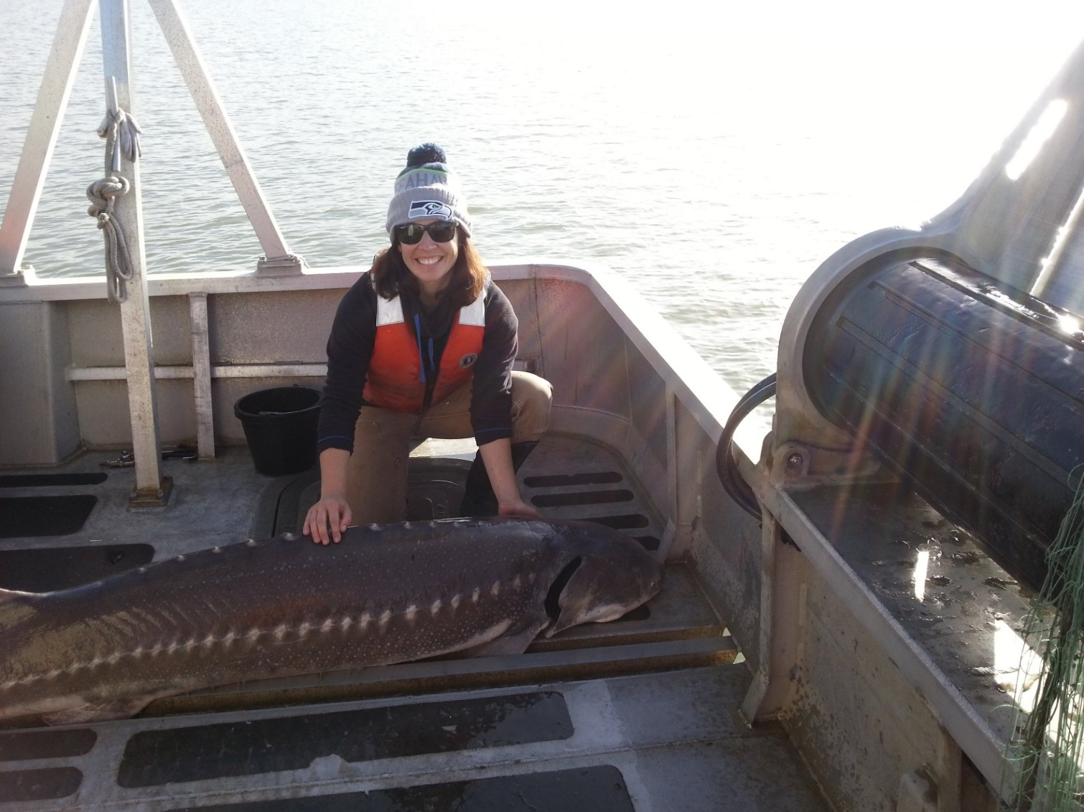
Results
Notes:
Hey everybody, look at this beautiful WST!!

Slide 20
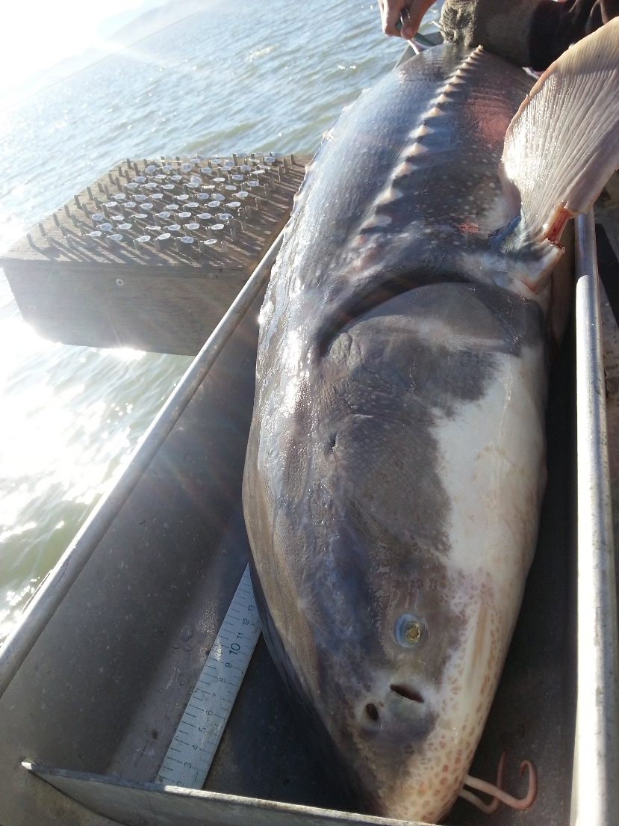
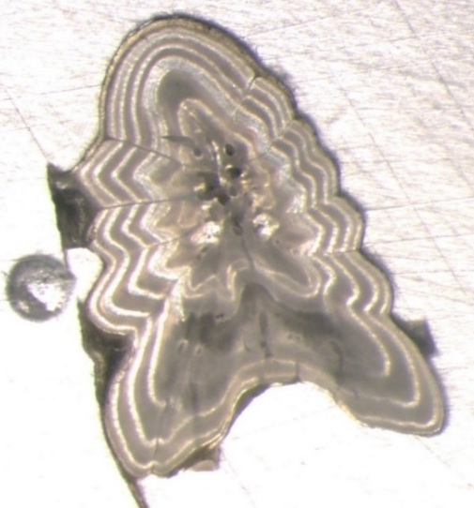
Results
CDFW trammel netting
1,000 White Sturgeon
374 pectoral fin rays

Slide 21
Results
n = 1,000

Slide 22
Results
n = 1,000
A = 28.9%

Slide 23
Results
L_{age} = 657 {1-e ^{[-0.014(age+4.266)]}}

Slide 24
Results

Slide 25
Results
Notes:
We used the cumulative average of 13.6% (±6.48%) as the base exploitation rate for the models

Slide 26
Population Growth Rate over 20 years
λ
Notes:
What is this scenario?
Base model under current slot limit with spawning periodicity of 15%

Slide 27
Spawning Periodicity 10%
λ
Notes:
What does lambda mean over periodicity? Is this annual? Or is this cumulative?
All 3 periods are over 20 years. 10% once every 10 yrs
15% 6 yrs
25% 4 yr

Slide 28
Spawning Periodicity 15%
λ

Slide 29
Spawning Periodicity 25%
λ

Slide 30
Elasticity analysis

Slide 31
Implications
Spawning periodicity
15% is likely most realistic
Slot length limit
Smaller harvest slot length limits seems to improve population growth rate…some
Exploitation
Greatest changes in population growth rates

Slide 32
Next Steps
Vital rate estimates
Sensitivity and elasticity analysis
Evaluate historic pectoral fin rays
Retrospective analysis

Slide 33



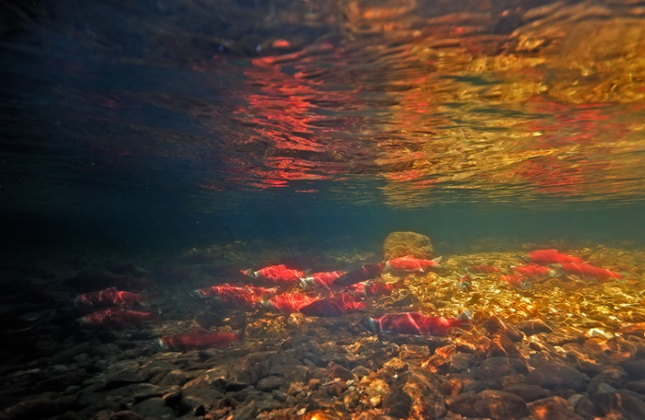
Acknowledgements
California Department of Fish and Wildlife
Dr. Russell Bellmer
Mike Harris
U.S. Fish and Wildlife Service
Laura Heironimus
Graham Mytton
Zack Jessee
University of Idaho
Dr. Sophie Gilbert
Quist lab

Slide 34

s

